Slide 1
Database

Slide 2
In order to install MicrosSoft SQL Server read slides:DBD Course07 DataBase Administration
.pptx, …pag. 60:
Preferably mixed mode authentication
Remember password for System Administrator
Make at least current user administrator
Make another user administrator

Slide 3
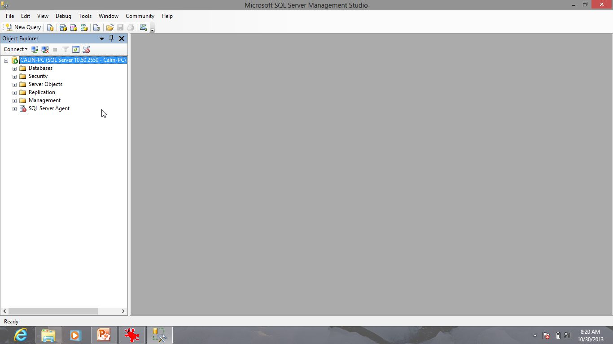
MS SQL Server Management Studio

Slide 4
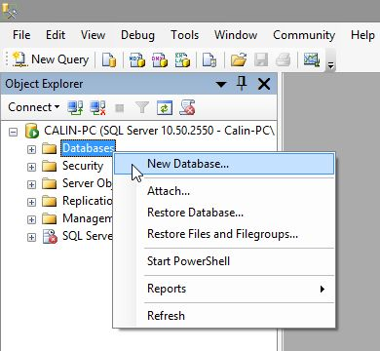
Right click to Create New Database

Slide 5
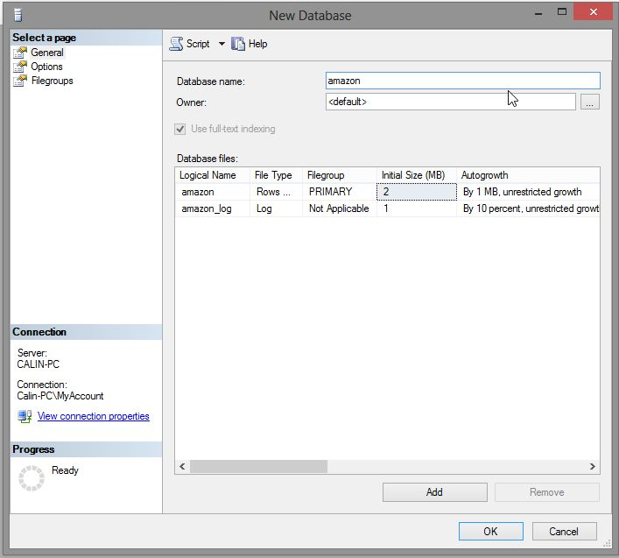
Create Database amazon

Slide 6
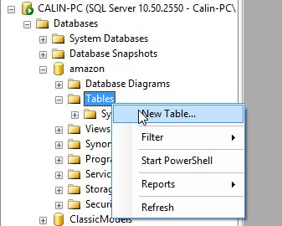
Database amazon Create New Table

Slide 7
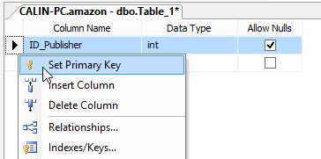
ID_Publisher – INTeger right click – Set Primary Key

Slide 8
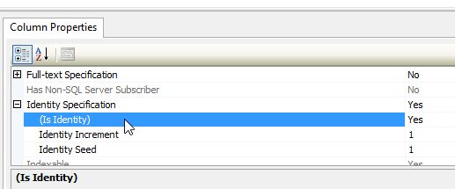
ID_Publisher – surrogate key Identity

Slide 9
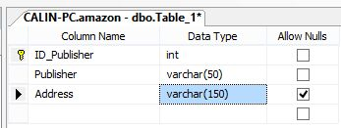
Publisher – VarChar(50) – Not NULL

Slide 10
Address – VarChar(150) –NULL allow

Slide 11
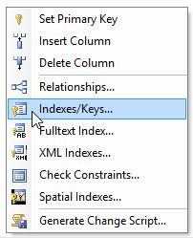
Create Index / Keys

Slide 12
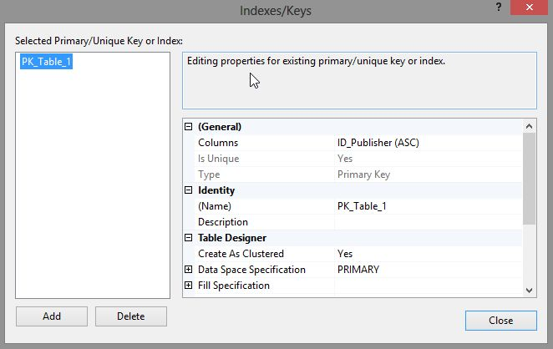
Index for PK already created

Slide 13
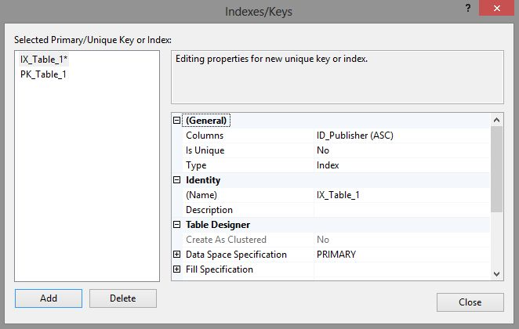
Add – New Index

Slide 14
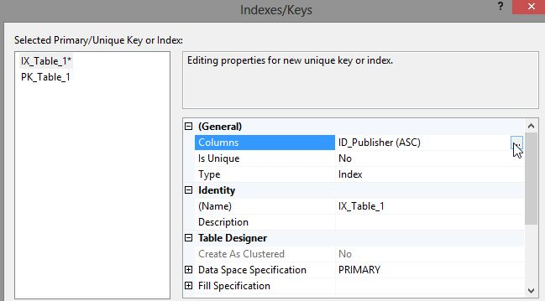
Choose Columns

Slide 15
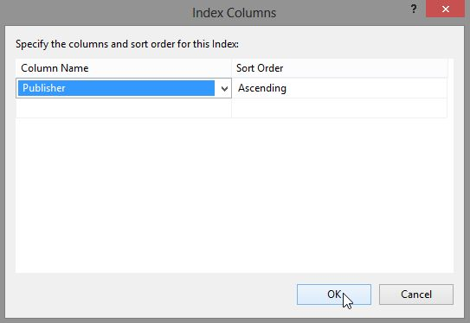
Publisher

Slide 16
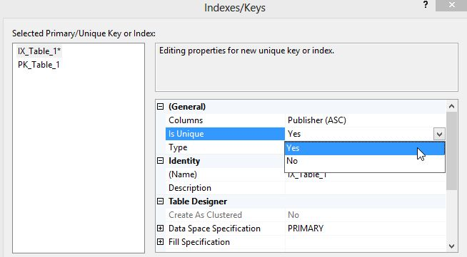
Is Unique

Slide 17
Publisher
ID_Publisher – INTeger – Identity – Primary Key (Not allow NULL)
Publisher – VarChar(50) - Alternate Key (Is Unique, Not allow NULL)
Address – VarChar(150) – allow NULL

Slide 18
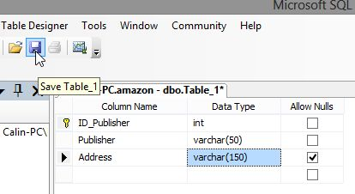
Save Table

Slide 19
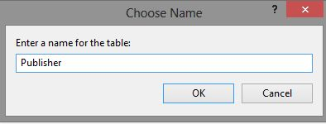
Table Publisher

Slide 20
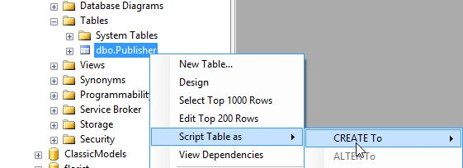
Script Table

Slide 21
CREATE TABLE [dbo].[Publisher](
CREATE TABLE [dbo].[Publisher](
[ID_Publisher] [int] IDENTITY(1,1) NOT NULL,
[Publisher] [varchar](50) NOT NULL,
[Address] [varchar](150) NULL,
CONSTRAINT [PK_Publisher] PRIMARY KEY CLUSTERED
(
[ID_Publisher] ASC
)WITH (PAD_INDEX = OFF, STATISTICS_NORECOMPUTE = OFF, IGNORE_DUP_KEY = OFF, ALLOW_ROW_LOCKS = ON, ALLOW_PAGE_LOCKS = ON) ON [PRIMARY]
) ON [PRIMARY]

Slide 22
CREATE TABLE Publisher
CREATE TABLE [dbo].[Publisher](
ID_Publisher int IDENTITY(1,1) NOT NULL,
Publisher varchar (50) NOT NULL,
Address varchar (150) NULL,
CONSTRAINT [PK_Publisher] PRIMARY KEY (
[ID_Publisher] ASC
))

Slide 23
CREATE TABLE Author
CREATE TABLE [dbo].[Author](
[ID_Author] [int] IDENTITY(1,1) NOT NULL,
[Author] [nvarchar](50) NOT NULL,
CONSTRAINT [PK_Author] PRIMARY KEY CLUSTERED
(
[ID_Author] ASC
))

Slide 24
CREATE TABLE Genre
CREATE TABLE [dbo].[Genre](
[ID_Genre] [int] IDENTITY(1,1) NOT NULL,
[Genre] [varchar](50) NOT NULL,
CONSTRAINT [PK_Genre] PRIMARY KEY CLUSTERED
(
[ID_Genre] ASC
))

Slide 25
CREATE TABLE Books
CREATE TABLE [dbo].[Book](
[ISBN] [char](13) NOT NULL,
[Title] [varchar](50) NOT NULL,
[Publisher_ID] [int] NOT NULL,
[Author_ID] [int] NULL,
[Price] [money] NOT NULL,
[Pages] [int] NULL,
[PubDate] [date] NULL,
[Description] [varchar](max) NULL,
CONSTRAINT [PK_Book] PRIMARY KEY CLUSTERED
( [ISBN] ASC ))

Slide 26
Varchar(MAX)
Description is VarChar(MAX) to replace deprecated TEXT, TLOB (Text Large OBject)
VarBinary(MAX) replace deprecated IMAGE, BLOB (Binary Large OBject)

Slide 27
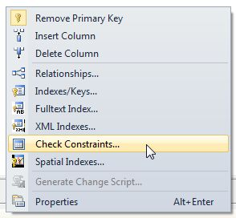
Check Constraint

Slide 28
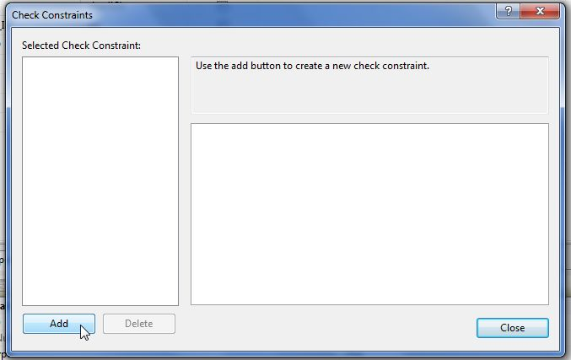
Add Check Constraint

Slide 29
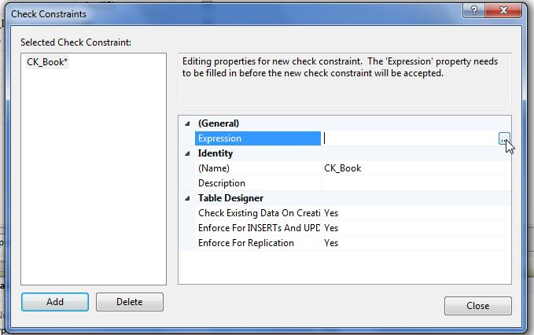
Expression

Slide 30
Constraints
Price > 0
Pages > 0 OR Pages IS NULL
ISBN LIKE '[0-9][0-9][0-9][0-9][0-9][0-9][0-9][0-9][0-9][0-9][0-9][0-9][0-9]'

Slide 31
CREATE TABLE Book_Genre
CREATE TABLE [dbo].[Book_Genre](
[ISBN] [char](13) NOT NULL,
[Genre_ID] [int] NOT NULL,
CONSTRAINT [PK_Book_Genre] PRIMARY KEY CLUSTERED
(
[ISBN] ASC,
[Genre_ID] ASC
))

Slide 32
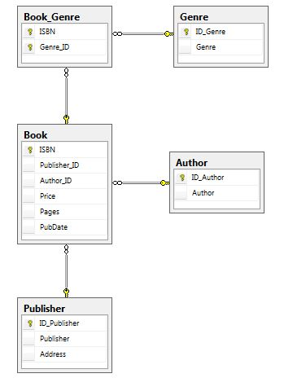
DataBase Diagram

Slide 33
Design is over …
Let’s try to fill some data

Slide 34
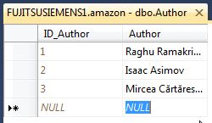
NVarChar …

Slide 35
View VBookGenre
SELECT dbo.Book.ISBN, dbo.Book.Title, dbo.Genre.Genre
FROM dbo.Book INNER JOIN
dbo.Book_Genre ON Book.ISBN = Book_Genre.ISBN INNER JOIN
Genre ON Book_Genre.Genre_ID = dbo.Genre.ID_Genre

Slide 36
View VBook
SELECT dbo.Book.ISBN, dbo.Book.Title, dbo.Author.Author, dbo.Publisher.Publisher, dbo.Book.Price, dbo.Book.Pages, dbo.Book.PubDate, dbo.Book.Description
FROM dbo.Author INNER JOIN
dbo.Book ON dbo.Author.ID_Author = dbo.Book.Author_ID INNER JOIN
dbo.Publisher ON dbo.Book.Publisher_ID = dbo.Publisher.ID_Publisher

Slide 37
DataBase Design – checked
Data – checked
External level – Views – checked
Spread the … database

Slide 38
BackUp & ReStore
Correct way
Backup & restore
2008 backup could be restored in 2012
2012 backup could not be restored in 2018
Script database way
Works for small database
Works both ways between different versions
Barbaric way
Attach, Detach

Slide 39
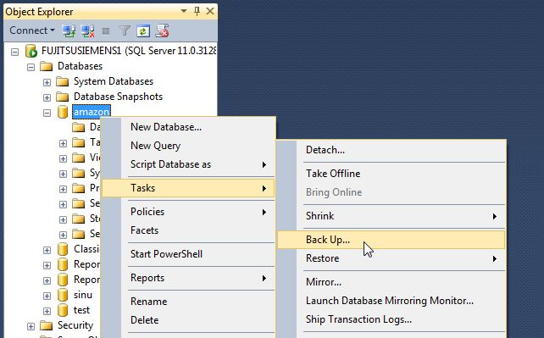

Slide 40
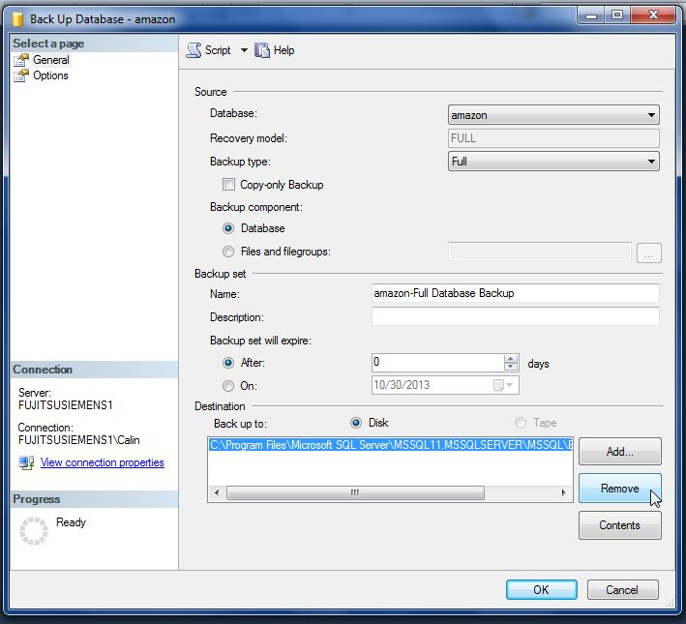
Never forget to Remove

Slide 41
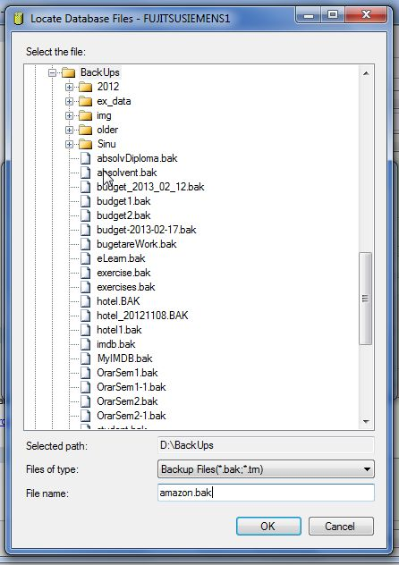
Add

Slide 42
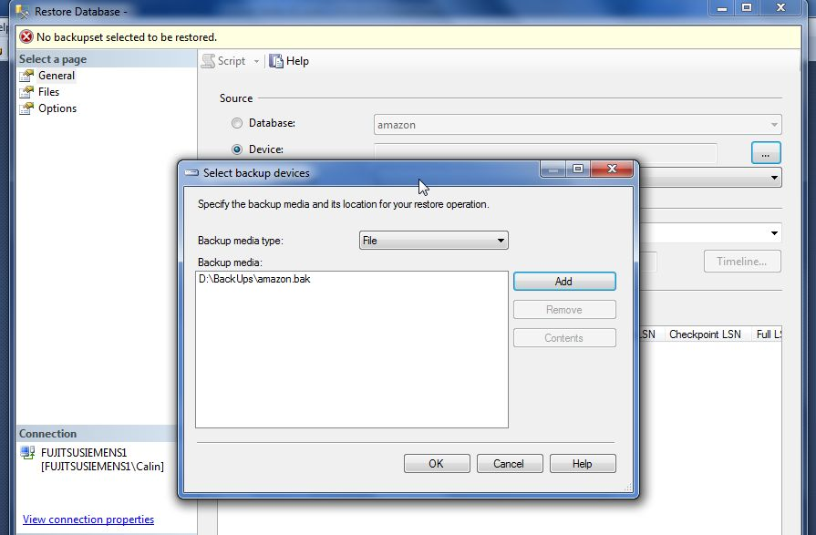
Restore - device

Slide 43
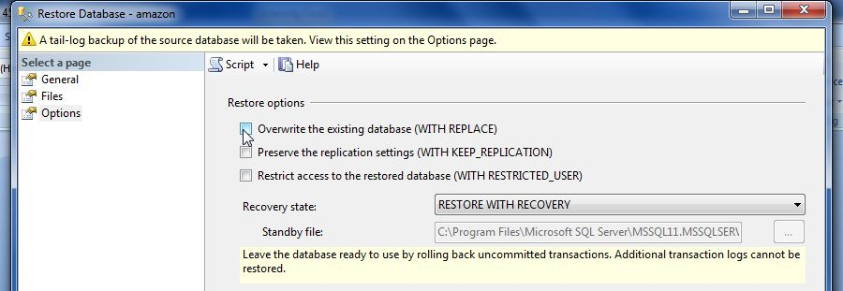
OverWrite the existing database

Slide 44
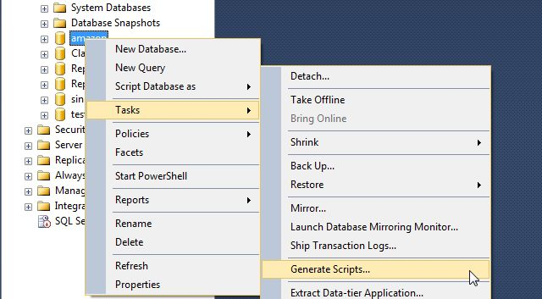
Generate Scripts

Slide 45
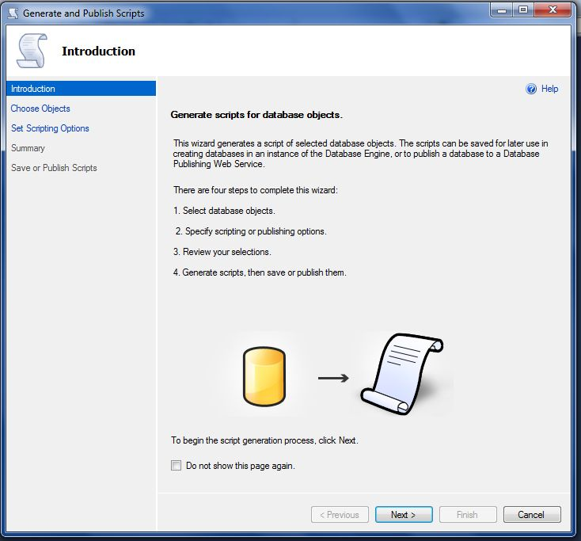

Slide 46
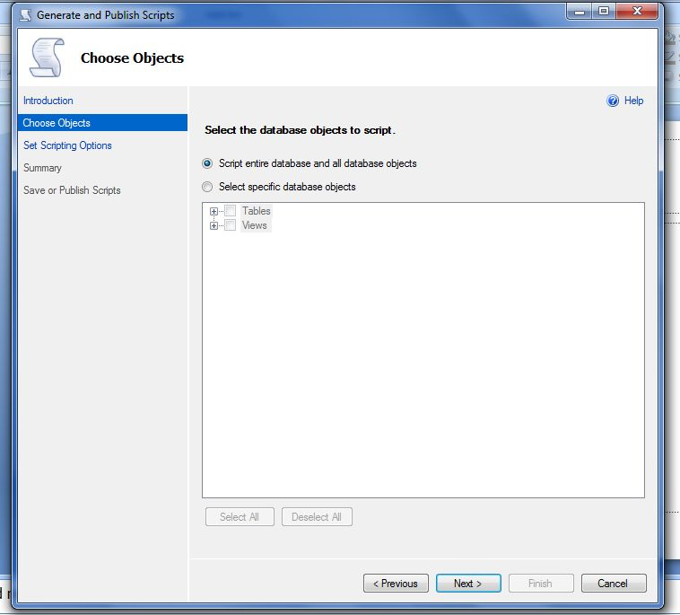

Slide 47
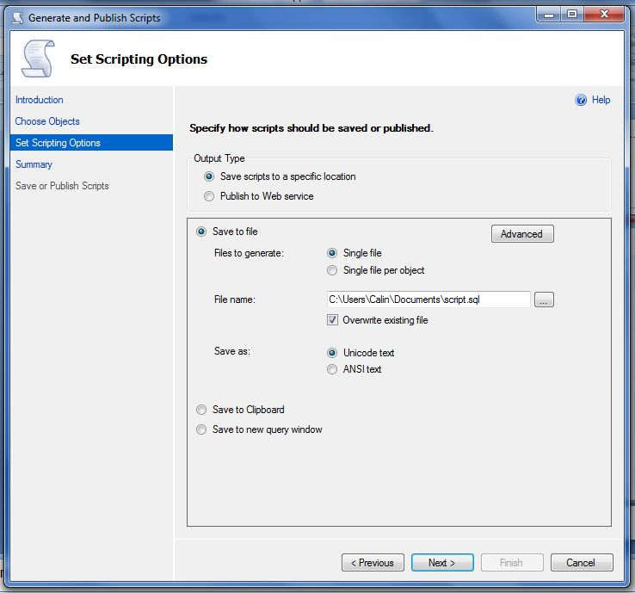

Slide 48
Script entire database and all database objects

